Slide 1





Built-in Functions
Functions and Wildcards
in SQL Server
Functions
& Wildcards
SoftUni Team
Technical Trainers
Software University
http://softuni.bg

Slide 2

Table of Contents
Function Overview
String Functions
Math Functions
Date Functions
Other Useful Functions
Wildcards

Slide 3
Questions
sli.do #CSharpDB

Slide 4

Functions in SQL Server
Overview

Slide 5

SQL Functions
String Functions – for manipulating text
Either Table values or user input
E.g. concatenate column values
Math Functions – calculations and working with aggregate data
E.g. perform geometry and currency operations
Date and Time Functions
E.g. find length of timespan
Miscellaneous Functions

Slide 6

String Functions
CONCAT, SUBSTRING, Etc.

Slide 7
String Functions
Concatenation – combine strings
CONCAT replaces NULL values it with empty string
SELECT FirstName + ' ' + LastName
AS [Full Name]
FROM Employee
SELECT CONCAT(FirstName, ' ', LastName)
AS [Full Name]
FROM Employee

Slide 8
String Functions (2)
SUBSTRING – extract part of a string
Example: get short summary of article
SUBSTRING(String, StartIndex, Length)
SUBSTRING('SoftUni', 5, 3)
Uni
Index is 1-based!
SELECT ArticleId, Author, Content,
SUBSTRING(Content, 1, 200) + '...' AS Summary
FROM Articles

Slide 9
String Functions (3)
REPLACE – replace specific string with another
Example: censor the word blood from album names
REPLACE(String, Pattern, Replacement)
REPLACE('SoftUni', 'Soft', 'Hard')
HardUni
SELECT REPLACE(Title, 'blood', '*****')
AS Title
FROM Album

Slide 10
String Functions (4)
LTRIM & RTRIM – remove spaces from either side of string
LEN – counts the number of characters
DATALENGTH – get number of used bytes (double for Unicode)
LTRIM(String)
RTRIM(String)
LEN(String)
DATALENGTH(String)

Slide 11
String Functions (5)
LEFT & RIGHT – get characters from beginning or end of string
Example: name shorthand (first 3 letters)
LEFT(String, Count)
RIGHT(String, Count)
SELECT Id, Start,
LEFT(Name, 3) AS Shorthand
FROM Games

Slide 12
Problem: Obfuscate CC Numbers
Our database contains credit card details for customers
Provide a summary without revealing the serial numbers
ID | FirstName | LastName | PaymentNumber
1 | Guy | Gilbert | 5645322227179083
2 | Kevin | Brown | 4417937746396076
… | … |  | …
ID | FirstName | LastName | PaymentNumber
1 | Guy | Gilbert | 564532**********
2 | Kevin | Brown | 441793**********
… | … |  | …

Slide 13
Solution : Obfuscate CC Numbers
We reveal the first 6 digits and obfuscate the rest
Bonus – create View for use by client apps
SELECT CustomerID,
FirstName,
LastName,
LEFT(PaymentNumber, 6) + '**********'
FROM Customers
CREATE VIEW v_PublicPaymentInfo AS
…

Slide 14
String Functions (6)
LOWER & UPPER – change letter casing
REVERSE – reverse order of all characters in string
REPLICATE – repeat string
LOWER(String)
UPPER(String)
REVERSE(String)
REPLICATE(String, Count)

Slide 15
String Functions (7)
CHARINDEX – locate specific pattern (substring) in string
STUFF – insert substring at specific position
Optional, begins at 1
CHARINDEX(Pattern, String, [StartIndex])
STUFF(String, StartIndex, Length, Substring)
Number of chars
to delete

Slide 16

Math Functions
Arithmetic, PI, ABS, ROUND, etc.

Slide 17
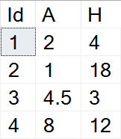
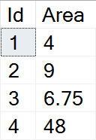
Math Functions
SQL Server supports basic arithmetic operations
Addition, subtraction, etc.
Example: find area of triangles by given side and height
SELECT Id,
(A*H)/2 AS Area
FROM Triangles

Slide 18
Math Functions (2)
PI – get the value of Pi as float (15 –digit precision)
ABS – absolute value
SQRT – square root (result will be float)
SQUARE – raise to power of two
SELECT PI() --3.14159265358979
ABS(Value)
SQRT(Value)
SQUARE(Value)

Slide 19
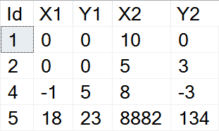
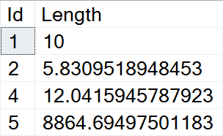
Example: Line Length
Find the length of a line by given coordinates of end points
SELECT Id,
SQRT(SQUARE(X1-X2) + SQUARE(Y1-Y2))
AS Length
FROM Lines

Slide 20
Math Functions (3)
POWER – raise value to desired exponent
ROUND – obtain desired precision
Negative precision rounds characters before decimal point
FLOOR & CEILING – return the nearest integer
POWER(Value, Exponent)
ROUND(Value, Precision)
FLOOR(Value)
CEILING(Value)

Slide 21
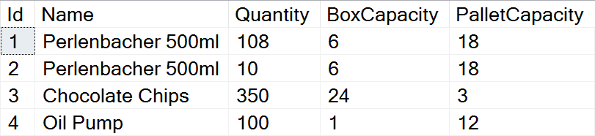
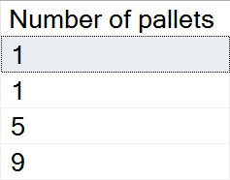
Problem: Pallets
Calculate the required number of pallets to ship each item
BoxCapacity specifies how many items can fit in one box
PalletCapacity specifies how many boxes can fit in a pallet

Slide 22
Solution: Pallets
Since we can't use half a box or half a pallet, we need to round up to the nearest integer value
SELECT
CEILING(
CEILING(
CAST(Quantity AS float) /
BoxCapacity) / PalletCapacity)
AS [Number of pallets]
FROM Products

Slide 23
Math Functions (4)
SIGN – returns 1, -1 or 0, depending on value sign
RAND – get a random float value in range [0,1)
If Seed is not specified, one is assigned at random
SIGN(Value)
RAND()
RAND(Seed)

Slide 24

Date Functions
GETDATE, DATEDIFF, DATEPART, etc.

Slide 25
Date Functions
DATEPART – extract a segment from a date as an integer
Part can be any part and format of date or time
For a full list, see the official documentation
DATEPART(Part, Date)
year, yyyy, yy
YEAR(Date)
month, mm, m
MONTH(Date)
day, dd, d
DAY(Date)

Slide 26
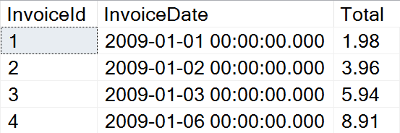
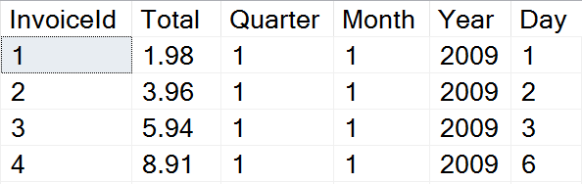
Problem: Quarterly Report
Prepare sales data for aggregation by displaying yearly quarter, month, year and day of sale

Slide 27
Solution: Quarterly Report
Use DATEPART to get the relevant parts of the date
This statement might be useful as a View
SELECT InvoiceId, Total,
DATEPART(QUARTER, InvoiceDate) AS Quarter,
DATEPART(MONTH, InvoiceDate) AS Month,
DATEPART(YEAR, InvoiceDate) AS Year,
DATEPART(DAY, InvoiceDate) AS Day
FROM Invoice

Slide 28
Date Functions (2)
DATEDIFF – find difference between two dates
Part can be any part and format of date or time
Example: Show employee experience
DATEDIFF(Part, FirstDate, SecondDate)
SELECT ID, FirstName, LastName,
DATEDIFF(YEAR, HireDate, '2017/01/25')
AS [Years In Service]
FROM Employees

Slide 29
Date Functions (3)
DATENAME – get a string representation of a date's part
DATEADD – perform date arithmetic
Part can be any part and format of date or time
GETDATE – obtain current date and time
DATENAME(Part, Date)
SELECT DATENAME(weekday, '2017/01/27')
DATEADD(Part, Number, Date)
SELECT GETDATE()

Slide 30


Other Functions
CAST, CONVERT, OFFSET, FETCH

Slide 31
Other Functions
CAST & CONVERT – convert between data types
ISNULL – swap NULL values with a specified default value
Example: Display “Not Finished” for projects with no EndDate
CAST(Data AS NewType)
CONVERT(NewType, Data)
ISNULL(Data, DefaultValue)
SELECT ProjectID, Name,
ISNULL(CAST(EndDate AS varchar), 'Not Finished')
FROM Projects

Slide 32
Other Functions(2)
OFFSET & FETCH – get only specific rows from the result set
Used in combination with ORDER BY for pagination
SELECT ID, FirstName, LastName
FROM Employees
ORDER BY ID
OFFSET 10 ROWS
FETCH NEXT 5 ROWS ONLY
Rows to skip
Rows to include

Slide 33

Wildcards
Selecting results by partial match

Slide 34
Using WHERE … LIKE
Wildcards are used with WHERE to filter for partial match
Similar to Regular Expressions, but less capable
Example: Find all employees who's first name starts with "Ro"
SELECT ID, FirstName, LastName
FROM Employees
WHERE FirstName LIKE 'Ro%'
Wildcard symbol

Slide 35
Wildcard Characters
Supported characters include
ESCAPE – specify prefix to treat special characters as normal
% -- any string, including zero-length
_ -- any single character
[…] -- any character within range
[^…] -- any character not in the range
SELECT ID, Name
FROM Tracks
WHERE Name LIKE '%max!%' ESCAPE '!'

Slide 36
Summary
SQL Server provides various built-in functions
String functions allow us to manipulate strings
CONCAT, LEFT/RIGHT, REPLACE, etc.
Math functions allow us to do various calculations
PI, ABS, POWER, ROUND, etc.
Date functions allow us to work with dates easier
DATEPART, DATEDIFF, GETDATE, etc.
Using Wildcards, we can obtain results by partial string matches

Slide 37







Built-in Functions
https://softuni.bg/courses/databases-basics-ms-sql-server

Slide 38






SoftUni Diamond Partners

Slide 39






SoftUni Diamond Partners

Slide 40
License
This course (slides, examples, demos, videos, homework, etc.) is licensed under the "Creative Commons Attribution-NonCommercial-ShareAlike 4.0 International" license
Attribution: this work may contain portions from
"Databases" course by Telerik Academy under CC-BY-NC-SA license

Slide 41





Trainings @ Software University (SoftUni)
Software University – High-Quality Education, Profession and Job for Software Developers
softuni.bg
Software University Foundation
http://softuni.foundation/
Software University @ Facebook
facebook.com/SoftwareUniversity
Software University Forums
forum.softuni.bg

